Slide 1


CAP 275
Computer Networks
Lecture #0
By Dr. Sanjeev Kumar Mandal

Slide 2
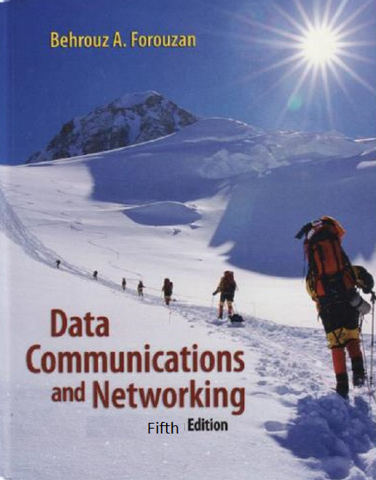

Course details
LTP – 3 0 0
[Three Lectures Hours/week]
Text Book
Data Communication and Networking
  by Behrouz .A. FOROUZAN,
  MCGRAW HILL, EDUCATION
  Rs. 450-550 (Jan 2018 -depends
  upon source)

Slide 3

Course Assessment Model
Marks break up
Attendance 5
CA(Best 2 out of 3) 25
MTE 20
ETE 50
Total 100

Slide 4

Revised Bloom’s Taxonomy
REVISED BLOOM’S TAXONOMY

Slide 5
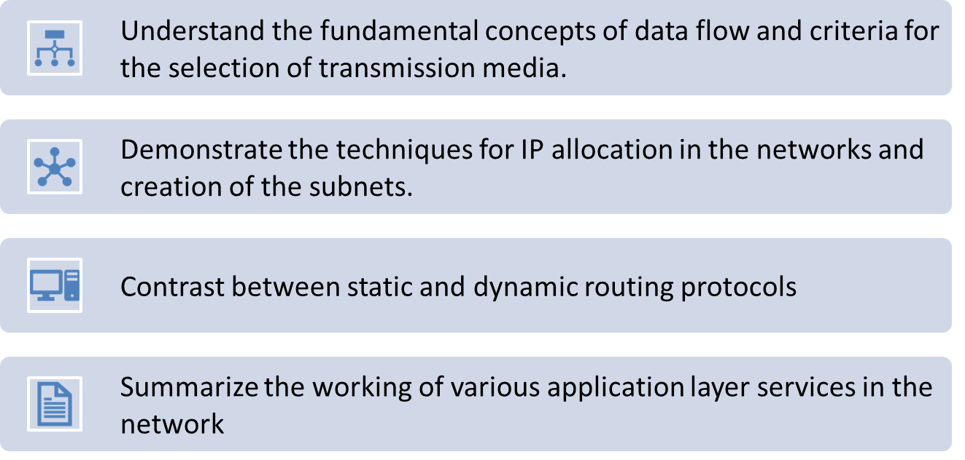
Course Outcomes:

Slide 6
Course Objectives
Examine the importance of data communication in daily activities
Recognize the different networking devices and their functionalities
Utilize the role of protocols in networking and analyze the services and features
Various layers of the network
Validate that the program, data, and hardware is available to everyone on the network without regard to the physical location of the resource and the users
Examine how users are authenticated by their user name and password

Slide 7

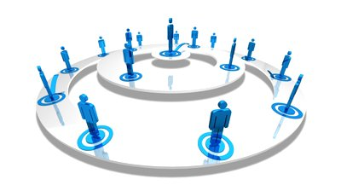
Why Computer Networks
✓ | Provide help in making good place in Computer Networking field
✓ | Alignment of learning objectives with job skills
✓ | To acquire well known Industry Certifications

Slide 8
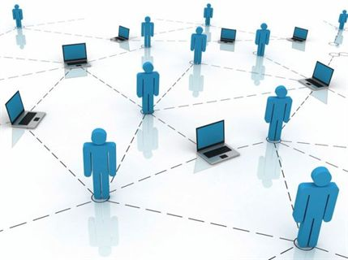


UNIT I : Basic Concept

Slide 9

UNIT I : Basic Concept

Slide 10
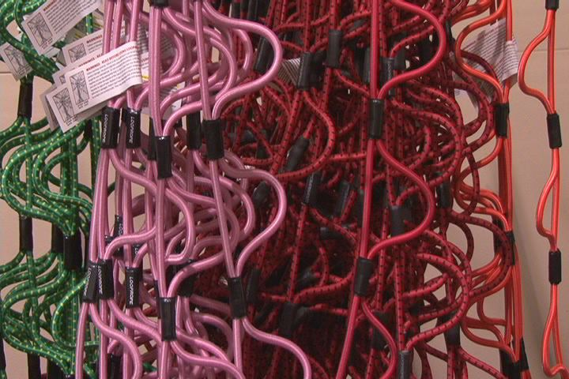
Unit 2: Physical Layer

Slide 11
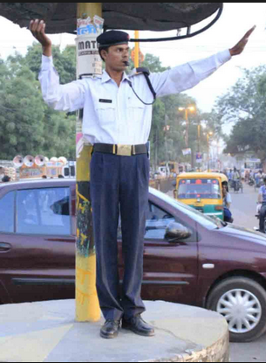
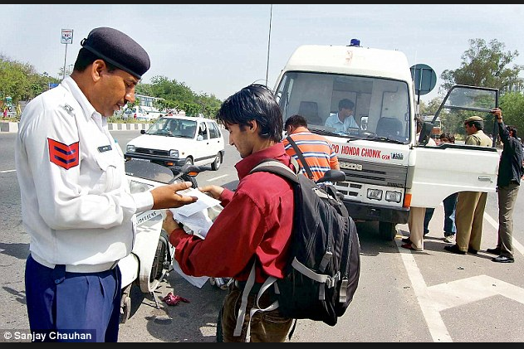
Unit 3: Data Link Layer

Slide 12

UNIT 4 : Network Layer
Check the complexity of the path and choosing the optimal path

Slide 13
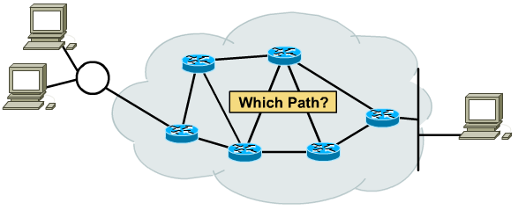

IP Routing

Slide 14
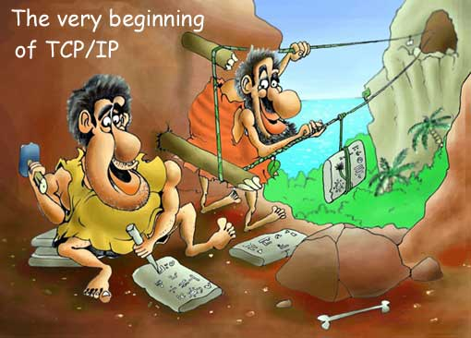
UNIT 5 : Transport Layer

Slide 15

Unit 6: Application layer and network security.

Slide 16

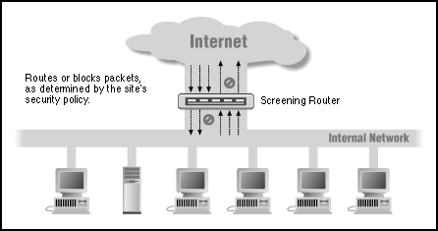
Unit 6: Application layer and network security.

Slide 17

Next Class: Components of Networking

